Slide 1

Predicting State of Health(SOH) of Lithium-Ion Batteries
Team Members:
Kshitij Kamble
Ritika Bhoite
Shivani Sriram
Devaki Thakare
Rajeshwari Patil

Slide 2

The Challenges with SOH Prediction of Lithium-Ion Batteries ​
Non-linear degradation: Influenced by factors such as temperature, charge/discharge cycles and usage patterns​.
Scaling issues: Difficult to monitor thousands of cells in large battery packs. ​
Environmental challenges: Performance drops under extreme temperatures or rapid cycling.​
No support for real-time SOH prediction: Critical for Electric vehicles (EVs) and grid storage systems.

Slide 3

Problem Statement
Prediction of the State of Health (SOH) of Lithium-Ion batteries that are commonly used in Electric Vehicles (EVs).

Slide 4

Machine Learning Approach for SOH Prediction​ ​
This approach will utilize data-driven models to analyze patterns and predict battery health based on features like current, voltage, temperature and charge/discharge cycles.​
​
Advantages Over Traditional Methods:​
Real-time prediction capability taking into consideration the non-linear degradation.​
Can handle complex, non-linear relationships between battery parameters.​
Scalable for large battery systems and adaptable to different battery designs.​
Cost-effective as it reduces reliance on physical testing.​

Slide 5

Gradient Boosting for SOH Prediction​
It is highly effective for regression tasks, making it ideal for SOH prediction.​
It helped to achieve reliable SOH predictions with minimal errors.​
Captured complex relationships between features and SOH.​

Slide 6
Workflow
Start
Raw Data
Data Preparation
Feature Engineering
Data Preprocessing
End
Model Deployment
Model Evaluation
Model Development

Slide 7
Project Demo

Slide 8
Result
Metrics on training dataset:
Train MAE: 0.048341625896815704
Test MAE: 0.24357640210652323
Train RMSE: 0.06598876002332116
Test RMSE: 0.34731585750875704
Train R2: 0.999992036680129
Test R2: 0.9988703334804062
Metrics on validation dataset:
Validation MAE: 0.2117
Validation RMSE: 0.6873
Validation R2: 0.9995
Metrics on validation dataset (5-10% added noise):
Validation MAE: 1.0372
Validation RMSE: 1.6070
Validation R2: 0.9972
Metrics on validation dataset (20-30% added noise):
Validation MAE: 2.9367
Validation RMSE: 4.5186
Validation R2: 0.9776

Slide 9
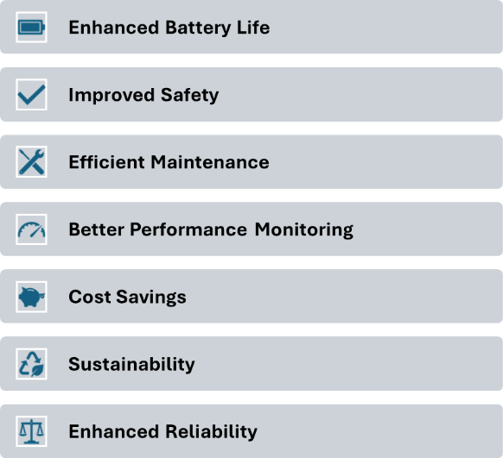
Why Machine Learning Approach works for SOH Prediction

Slide 10
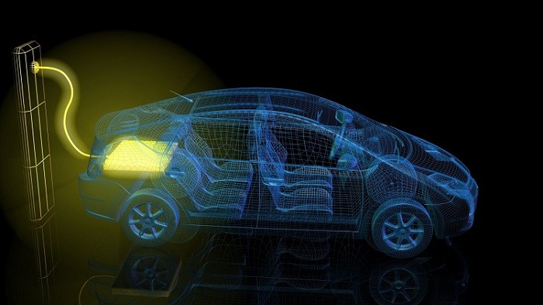
Thank you

